Slide 1
Math 152
Lesson | Topic | Reading
38 | 3D Systems | 12.1 / 12.2
39 | Dot Product | 12.3
40 | Cross Product | 12.4
Objectives:
Calculate the dot (scalar) product of two vectors
Use the dot product to calculate the angle between two vectors
Use the dot product to determine if two vectors are orthogonal
Calculate scalar projections and vector projections
Use dot product properties to solve work problems when the applied force is not in direction of distance travelled

Slide 2
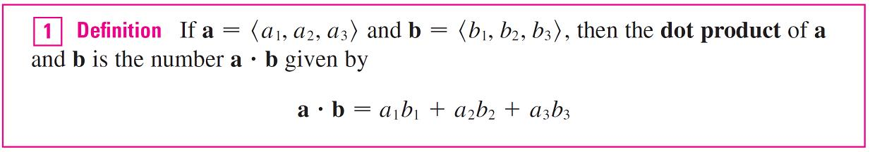
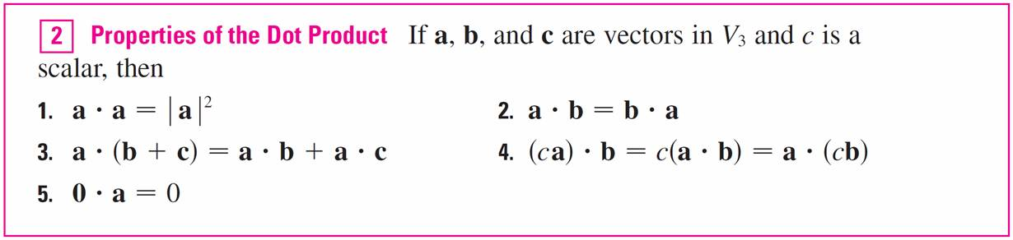
Dot Product
⟨2, 4⟩  ⟨3, –1⟩ = 2(3) + 4(–1) = 2
(i + 2j – 3k)  (2j – k) = 1(0) + 2(2) + (–3)(–1) = 7

Slide 3
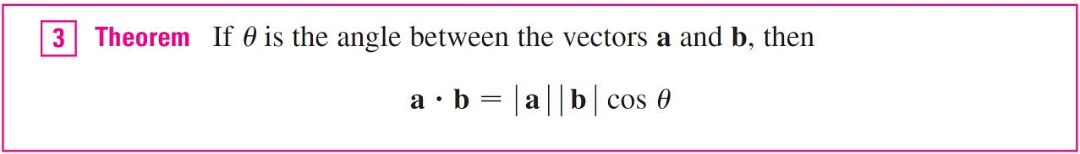
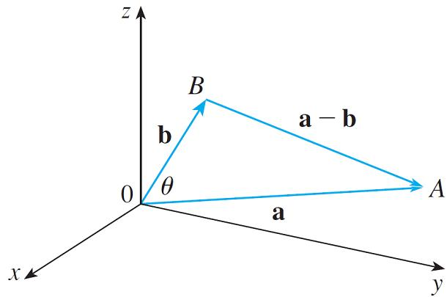
Angles
a  b = | a | | b | cos(π /3) = 4  6  1/2 = 12

Slide 4
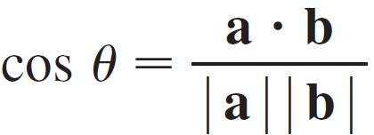
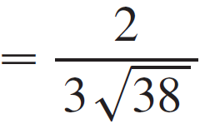
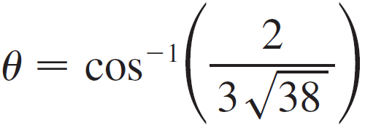
Example
Find the angle between the vectors a = ⟨2, 2, –1⟩ and b = ⟨5, –3, 2⟩.
Solution:
a  b = 2(5) + 2(–3) + (–1)(2) = 2

Slide 5
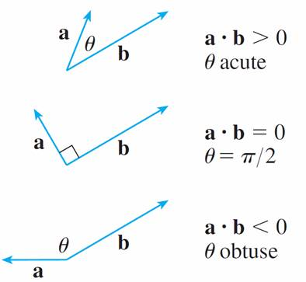
Dot Product Properties

Slide 6
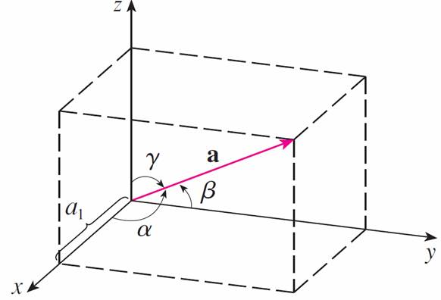
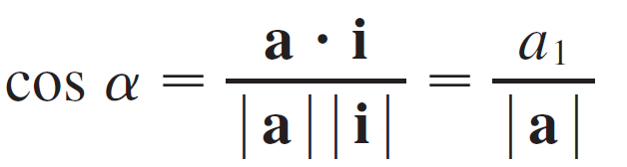
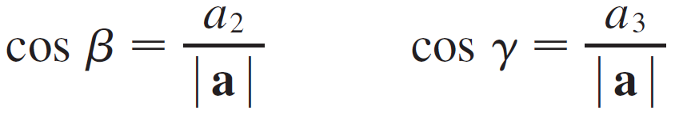
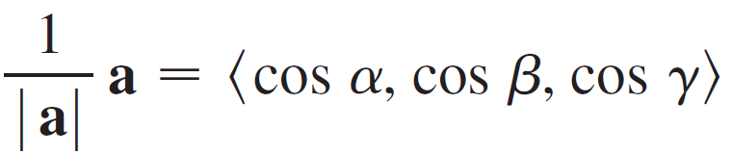
Direction Cosines
In analytic geometry, the direction cosines (or directional cosines) of a vector are the cosines of the angles between the vector and the three coordinate axes. Or equivalently it is the component contributions of the basis to the unit vector.
cos²α + cos²β + cos²γ = 1

Slide 7
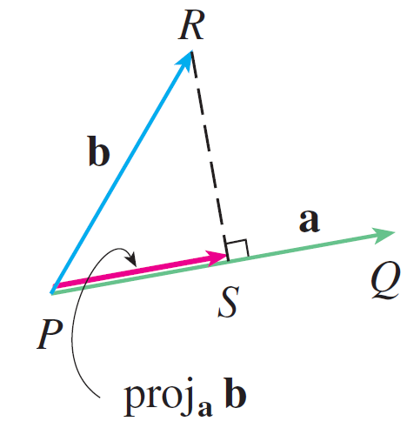
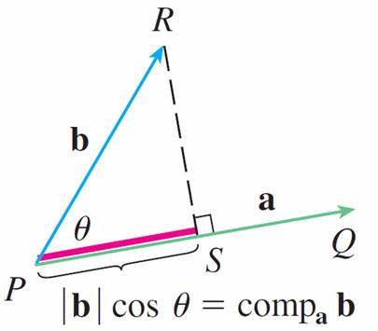
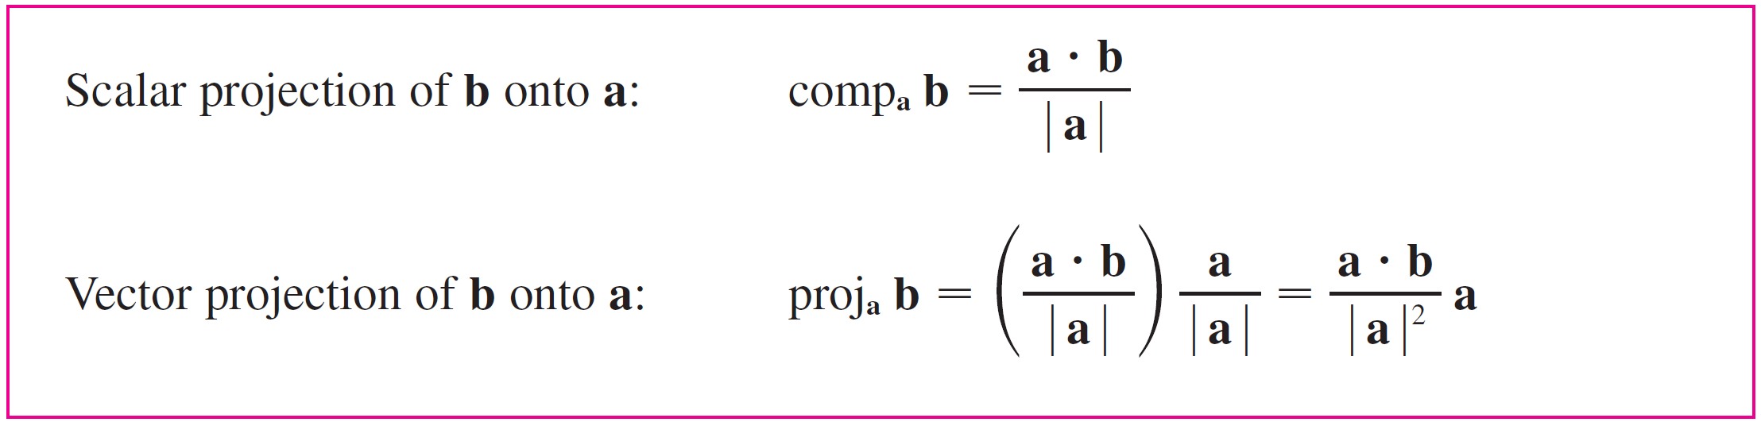
Projections
Positive
negative

Slide 8
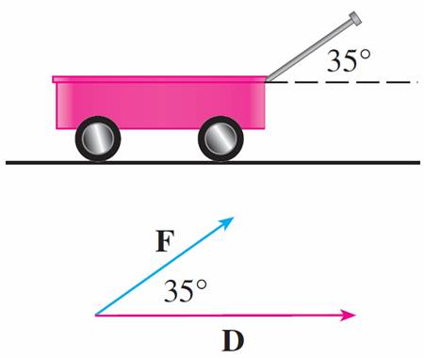
Example 7
A wagon is pulled a distance of (100,0) m by a constant force of (57.3,40.15) N. The handle is at an angle of 35°. Find the work done by the force.
Solution:
W = F  D = 57.34*100+40.15*0 = 5734 Nm = 5734 J

Slide 10
Basis
In mathematics, the standard basis (also called natural basis or canonical basis) for a Euclidean space is the set of unit vectors pointing in the direction of the axes of a Cartesian coordinate system.
The vector e_{x} points in the x direction, the vector e_{y} points in the y direction, and the vector e_{z} points in the z direction. There are several common notationsfor these vectors, including {e_{x}, e_{y}, e_{z}}, {e₁, e₂, e₃}, {i, j, k}, and {x, y, z}. These vectors are sometimes written with a hat to emphasize their status as unit vectors.

